Slide 1
Cs-381 Software Engineering
Course Instructor: Dr. Shazia Arshad
Notes:
Welcome to all of you in this course. I am Dr. Shazia Arshad. I will be your instructor for this course.

Slide 2

WHat are Design Patterns?
Notes:
What is Design Pattern??
In software engineering, a design pattern is a general repeatable solution to a commonly occurring problem in software design.
It isn’t a finished design that can be transformed directly into code, but a description or template for how to solve a problem that can be used in many different situations.
A design pattern is a practical proven solution to a recurring design problem.
In software engineering, there come across the same design problem many times. There are so many ways to deal with these recurring problems but over time some solutions are preferred over others, because they're more flexible or reusable.
Instead of solving a particular software problem by basic Objectory into programming principles every time (building code from scratch),
Where you would have to decide what objects to use?
How objects need to relate and so on?
You can use previously outlined solutions that expert developers have often used.
These design solutions are not just theoretical concepts. These are actual solutions that are used in industrial software.
Example:
Think of design pattens like the way you would think of recipes in cooking. There are some dishes that people have experimented with and cooked repeatedly. After a while, a certain way of cooking a particular dish would be preferred because it creates the best tasting dish.
Over the years, developers have experimented with many different design solutions. And these design patterns outline solutions that often create the best outcome.

Slide 3

What are Design Patterns??
Notes:
Importance of Design Patterns:
Using design patterns is sort of like playing a game of chess. There are many ways to win by putting your opponent in checkmate. A beginner chess player may only know the basic moves of each piece. Whereas an expert chess player will look for appropriate patterns on the board. And these are patterns that experts will look to exploit while playing the game. Through experience, they are better able to judge which patterns to use or create in a particular situation to win the game.
Similar to chess, beginner software developers might only know the elements of language syntax in programming software. They know elements like how to create a for loop, a method, and so on. But with more practice and experience, these software developers will write more perfect code that follows common conventions. Also, they can become design experts who know the design patterns to use in solving particular software design problems.
Another thing to note about design patterns is that it's not just a concrete set of source code that you memorize and put into your software, like Java libraries or frameworks. Design patterns are a bit more conceptual. It is knowledge that you can apply within your software design to guide its structure and make it more flexible and reusable.

Slide 4
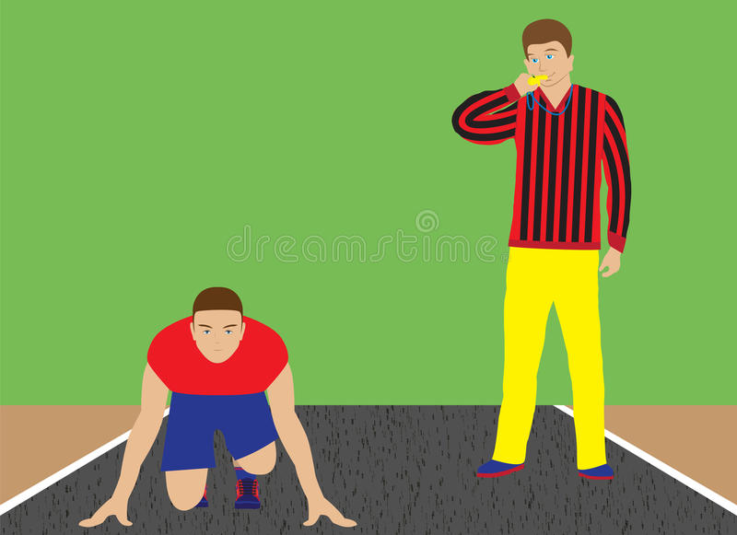
Why we need software PAtterns??
Notes:
Design patterns help software developers so that instead of building everything from scratch, they have a guide that helps them solve design problems in the way experts do.
Example:
A beginner athlete may have the natural talent and basic knowledge of the sport they are playing. But a couch with years of experience will be able to help that athlete to become better and use their talent to achieve greater things.
Design Patterns help to create a design vocabulary. Rather than having to explain the details of a design solution over, and over again, you can simplify the discussion by having a suggestive word to describe it. Design patterns help to address issue by giving each pattern a name and making it easier for developers to communicate. Knowledge of design patterns leaves less room for misunderstanding.

Slide 5
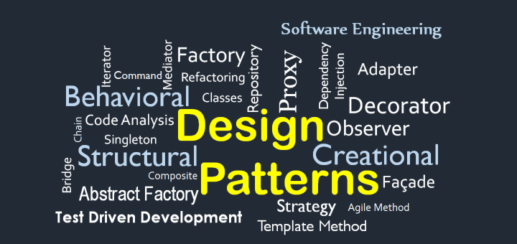
DESIGN PATTERNS
Gang of Four
Creational
Structural
Behavioral
Notes:
The four authors of the famous book Design Patterns: Elements of Reusable Object-Oriented Software have been collectively nicknamed the Gang of Four.
Pattern Language:
The patterns and solutions of the Gang of Four’s catalog serve a variety of different purposes. Depending on the context of the problem, you would select a different pattern language to use. A pattern language is a collection of patterns that are related to a certain problem space.
Example:
The pattern language you select for designing accounting software would be different than those you select for designing gaming software. A pattern language for accounting software would include double-entry bookkeeping, while a pattern language for gaming software would include design words such as encounters, quests, and players. Based on context, you must decide which ones will suit your problem or design issue the best.
Pattern Categories:
The Gang of Four’s pattern catalog contains twenty-three patterns. These patterns can be sorted into three different categories:
Creational patterns,
Structural patterns,
Behavioral patterns.
Some patterns might have elements that allow them to span all of the categories – it is not always clear cut which categories a pattern falls under.

Slide 6
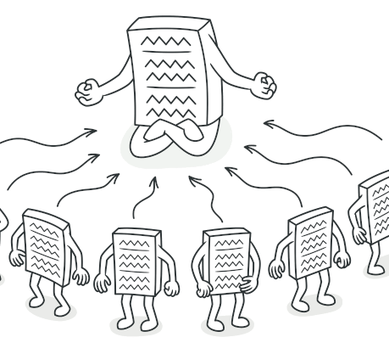
CREATIONAL DESIGN PATTERN ==>> Singleton
Class has only one instance
Single object is globally accessible within the program
Example:
A single database object shared by different parts of the program.
Notes:
Creational Design Patterns
In software engineering, creational design patterns are design patterns that deal with object creation mechanisms, trying to create objects in a manner suitable to the situation. The basic form of object creation could result in design problems or added complexity to the design. Creational design patterns solve this problem by somehow controlling this object creation.
Singleton Pattern:
In a singleton design pattern ensure a class has only one instance.
Another goal of singleton design pattern is that the single object is globally accessible within the program. Just like a global variable, the Singleton pattern lets you access some object from anywhere in the program. However, it also protects that instance from being overwritten by other code.
Problem
Application needs one, and only one, instance of an object.
Another goal of singleton design pattern is that the single object is globally accessible within the program.
In order to implement a singleton design pattern, best practice is to build the “one and only one” goal into the class itself, so that creating another instance of a Singleton class is not even possible.
When to Use??
Use the Singleton pattern when a class in your program should have just a single instance available to all clients; for example, a single database object shared by different parts of the program.
The Singleton pattern disables all other means of creating objects of a class except for the special creation method. This method either creates a new object or returns an existing one if it has already been created.
Use the Singleton pattern when you need stricter control over global variables.
Note that you can always adjust this limitation and allow creating any number of Singleton instances. The only piece of code that needs changing is the body of the getInstance() method.
For resources that are expensive to create (like database connection objects).
Classes that contain resources that are accessed in shared mode.

Slide 7
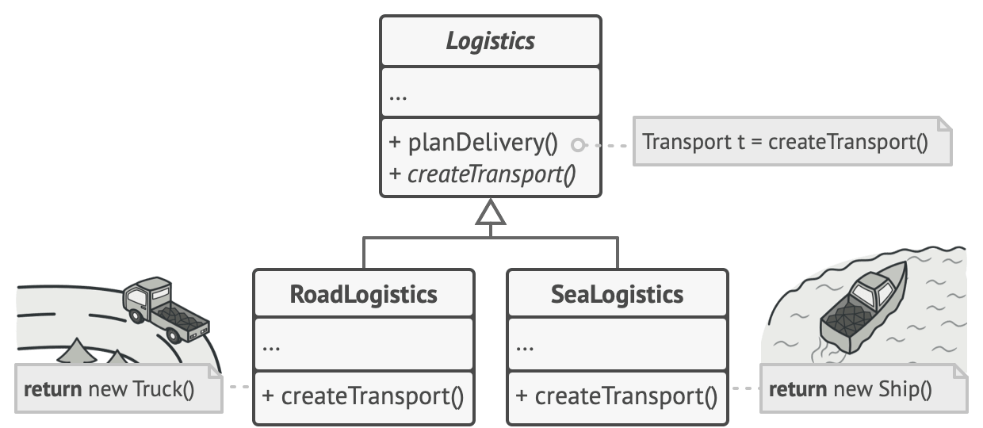
CREATIONAL DESIGN PATTERN ==>> FACTORY
Interface for creating objects in a superclass.
Allows subclasses to alter the type of objects that will be created.
Notes:
Factory Design Patterns
Factory Method is a creational design pattern that provides an interface for creating objects in a superclass but allows subclasses to alter the type of objects that will be created.
Problem
Imagine that you’re creating a logistics management application. The first version of your app can only handle transportation by trucks, so the bulk of your code lives inside the Truckclass. Each day you receive dozens of requests from sea transportation companies to incorporate sea logistics into the app. Adding Ships into the app would require making changes to the entire codebase. Moreover, if later you decide to add another type of transportation to the app, you will probably need to make all of these changes again.
Solution
The Factory Method pattern suggests that you replace direct object construction calls (using the new operator) with calls to a special factory method. The objects are still created via the new operator, but it’s being called from within the factory method. Objects returned by a factory method are often referred to as products.
When to Use??
Use the Factory Method when you want to save system resources by reusing existing objects instead of rebuilding them each time.
Use the Factory Method when you want to provide users of your library or framework with a way to extend its internal components.

Slide 8
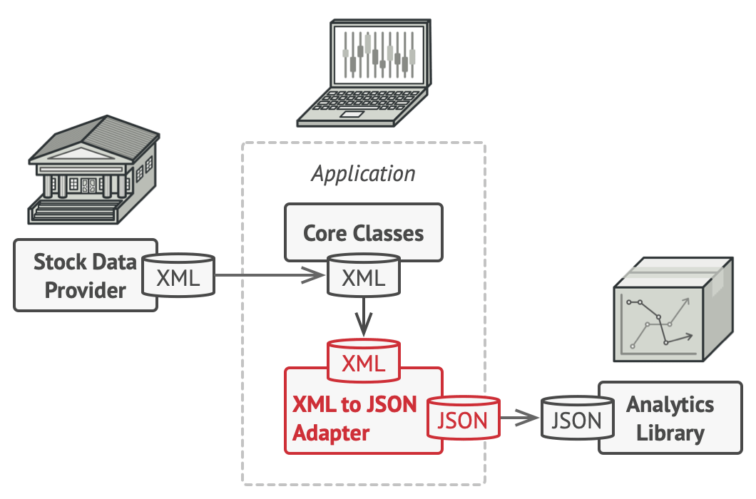
Structural DESIGN PATTERN ==>> Adaptive
Allows objects with incompatible interfaces to collaborate.
Example:
Different power plug and sockets.
Notes:
Structural Design Patterns
Structural design patterns show us how to glue different pieces of a system together in a flexible and extensible fashion. These patterns help us guarantee that when one of the parts changes, the entire application structure does not need to change.
Adapter Pattern:
Adapter is a structural design pattern that allows objects with incompatible interfaces to collaborate.
Problem
Imagine that you’re creating a stock market monitoring app. The app downloads the stock data from multiple sources in XML format and then displays nice-looking charts and diagrams for the user.
At some point, you decide to improve the app by integrating a smart 3rd-party analytics library. But there’s a catch: the analytics library only works with data in JSON format. You could change the library to work with XML. However, this might break some existing code that relies on the library. And worse, you might not have access to the library’s source code in the first place, making this approach impossible.
Solution
You can create an adapter. This is a special object that converts the interface of one object so that another object can understand it.
An adapter wraps one of the objects to hide the complexity of conversion happening behind the scenes. The wrapped object isn’t even aware of the adapter.
To solve the dilemma of incompatible formats, you can create XML-to-JSON adapters for every class of the analytics library that your code works with directly. Then you adjust your code to communicate with the library only via these adapters. When an adapter receives a call, it translates the incoming XML data into a JSON structure and passes the call to the appropriate methods of a wrapped analytics object.
When to Use??
Make sure that you have at least two classes with incompatible interfaces:
A useful service class, which you can’t change (often 3rd-party, legacy or with lots of existing dependencies).
One or several client classes that would benefit from using the service class.

Slide 9
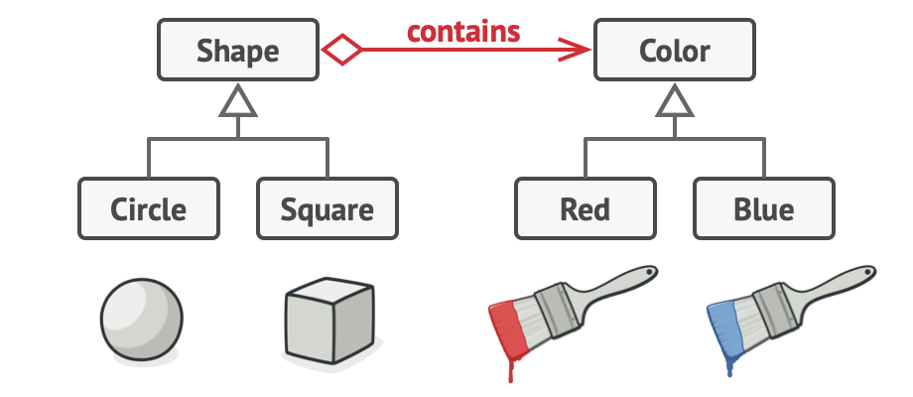
Structural DESIGN PATTERN ==>> Bridge
Lets you split a large class or a set of closely related classes into two separate hierarchies.
Creates a bridge between two hierarchies.
Notes:
Bridge Design Patterns
Bridge is a structural design pattern that lets you split a large class or a set of closely related classes into two separate hierarchies —abstraction and implementation—which can be developed independently of each other.
Problem
Say you have a geometric Shape class with a pair of subclasses: Circle and Square. You want to extend this class hierarchy to incorporate colors, so you plan to create Red and Blue shape subclasses. However, since you already have two subclasses, you’ll need to create four class combinations such as Blue Circle and Red Square. Adding new shape types and colors to the hierarchy will grow it exponentially.
Solution
This problem occurs because we’re trying to extend the shape classes in two independent dimensions: by form and by color. That’s a very common issue with class inheritance. The Bridge pattern attempts to solve this problem by switching from inheritance to the object composition. What this means is that you extract one of the dimensions into a separate class hierarchy, so that the original classes will reference an object of the new hierarchy, instead of having all of its state and behaviors within one class. Following this approach, we can extract the color-related code into its own class with two subclasses: Red and Blue. The Shape class then gets a reference field pointing to one of the color objects. Now the shape can delegate any color-related work to the linked color object. That reference will act as a bridge between the Shape and Color classes. From now on, adding new colors won’t require changing the shape hierarchy, and vice versa.
When to Use??
Use the Bridge pattern when you want to divide and organize a monolithic class that has several variants of some functionality.
Use the pattern when you need to extend a class in several orthogonal (independent) dimensions.

Slide 10
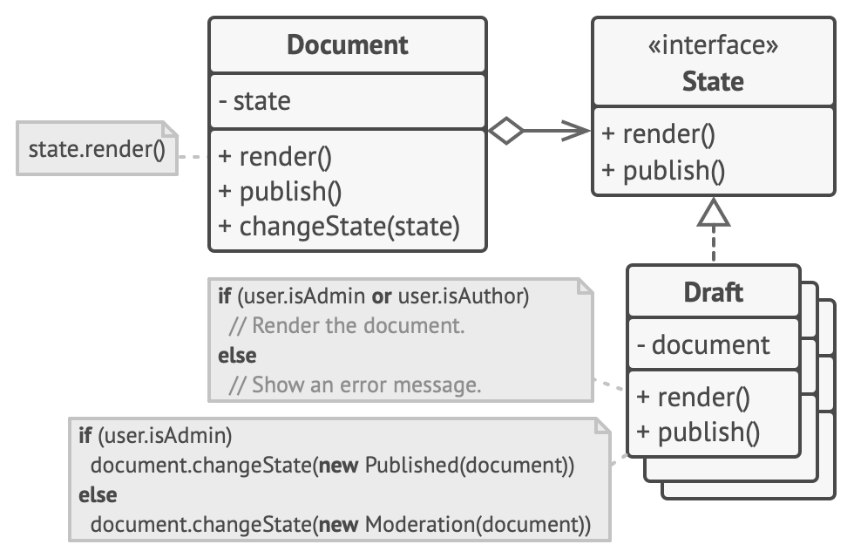
Behavioral DESIGN PATTERN ==>> State
Lets an object alter its behavior when its internal state changes
Related to the concept of a Finite-State Machine.
Example:
Switches in your smartphone
Notes:
Behavioral Design Patterns
Behavioral design patterns are concerned with the interaction and responsibility of objects.
In these design patterns, the interaction between the objects should be in such a way that they can easily talk to each other and still should be loosely coupled.
State Pattern:
State is a behavioral design pattern that lets an object alter its behavior when its internal state changes. It appears as if the object changed its class.
The State pattern is closely related to the concept of a Finite-State Machine.
The main idea is that, at any given moment, there’s a finite number of states which a program can be in. Within any unique state, the program behaves differently, and the program can be switched from one state to another instantaneously. However, depending on a current state, the program may or may not switch to certain other states.
Imagine that we have a Document class. A document can be in one of three states: Draft, Moderation and Published. The publish method of the document works a little bit differently in each state:
In Draft, it moves the document to moderation.
In Moderation, it makes the document public, but only if the current user is an administrator.
In Published, it doesn’t do anything at all.
Problem
The biggest weakness of a state machine based on conditionals reveals itself once we start adding more and more states and state-dependent behaviors to the Document class. Most methods will contain monstrous conditionals that pick the proper behavior of a method according to the current state. Code like this is very difficult to maintain because any change to the transition logic may require changing state conditionals in every method.
Solution
The State pattern suggests that you create new classes for all possible states of an object and extract all state-specific behaviors into these classes.
Instead of implementing all behaviors on its own, the original object, called context, stores a reference to one of the state objects that represents its current state, and delegates all the state-related work to that object.
When to Use??
Use the state pattern when you have an object that behaves differently depending on its current state, the number of states is enormous, and the state-specific code changes frequently.

Slide 11
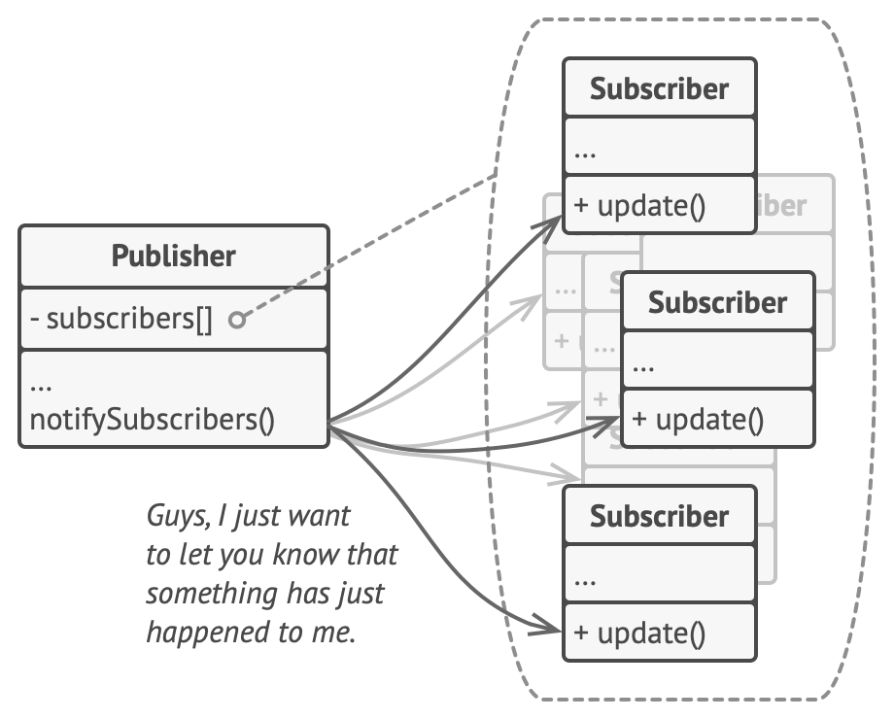
Behavioral DESIGN PATTERN ==>> OBSERVER
Lets you define a subscription mechanism to notify multiple objects about any events that happen to the object they’re observing.
Notes:
Observer Design Pattern
Observer is a behavioral design pattern that lets you define a subscription mechanism to notify multiple objects about any events that happen to the object they’re observing.
Problem
Imagine that you have two types of objects: Customer and a Store. The customer is very interested in a particular brand of product (say, it’s a new model of the iPhone) which should become available in the store very soon.
On the other hand, the store could send tons of emails (which might be considered spam) to all customers each time a new product becomes available. This would save some customers from endless trips to the store. At the same time, it’d upset other customers who aren’t interested in new products.
Solution
The object that has some interesting state is often called subject, but since it’s also going to notify other objects about the changes to its state, we’ll call it publisher. All other objects that want to track changes to the publisher’s state are called subscribers.
The Observer pattern suggests that you add a subscription mechanism to the publisher class so individual objects can subscribe to or unsubscribe from a stream of events coming from that publisher
Now, whenever an important event happens to the publisher, it goes over its subscribers and calls the specific notification method on their objects.
When to Use??
Use the Observer pattern when changes to the state of one object may require changing other objects.

Slide 12

TIME TO THINK
Give the implementation of design patterns and study all other design patterns????

